Slide 1

Accident Analysis And Prevention

Slide 2
Group number: 3
Group members:
Anvesh Muppeda (R11840667)
Saran Kumar (R11847468)
Sai Manasa Kota (R11863589)
Saketh Rao Vardhineni (R11840584)
Vishwasena Raidu Nyaramneni (R11849314)
Nikhilesh Reddy Peketi (R11841634)
Farooq Abdulla Shaik (R11842924)

Slide 3
Project Statement
Create a user interface to get the prediction on accident severity using the machine learning algorithm.
The created website can be accessed by anyone and also contains the login and signup pages which are vulnerable to certain kind of attacks.
Perform the attacks through DDOS and SQL Injection attacks.

Slide 4
Project Statement(cont.)
DDOS attack on the website can result in termination of the service which means the website will not be working due to overloaded packets. Mitigate the attack so the service won't be halted.
SQL Injection attack on the website login page may result in altering the details in the user database.
Implement the mitigation techniques for the above mentioned attacks.

Slide 5
Existing Problem
As of now, we are having only the info regarding the accident rates in a particular area.
We don't have any tool to predict the rate if accidents.
And there's no security present.

Slide 6
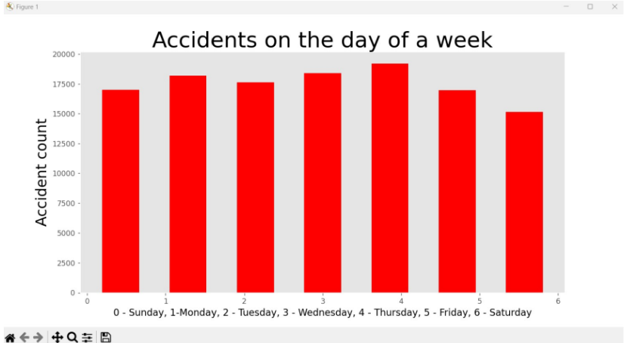
Results Graph

Slide 7
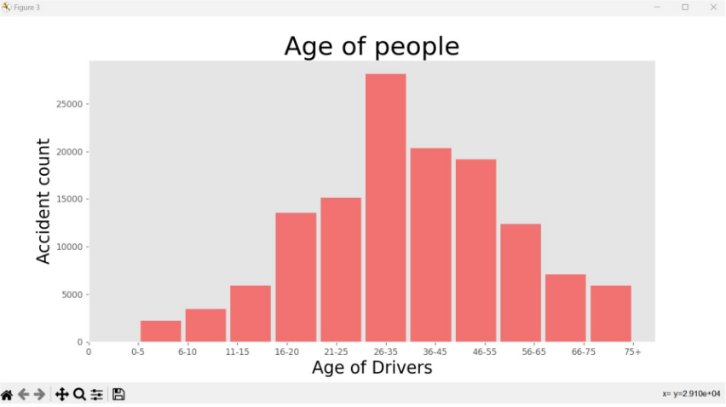
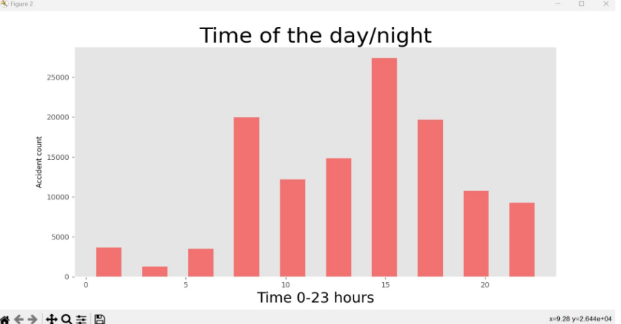
Results Graphs(cont.)

Slide 8
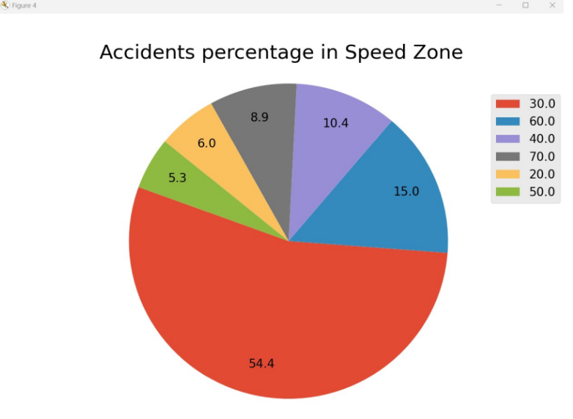
Results Pi-Graph

Slide 9
Proposed Solutions
For DDOS attack:
Collect all the logs from splunkforwader on splunk which includes the packets sent and the ip address from which the packets are being sent.
Get the IP address from which we are getting bulk amount of the packets in a short amount of time that increases the load of the server.
Block the IP address on the NACL with the help of AWS CLI from further inputting the packets.

Slide 10
Proposed Solutions(cont.)
For SQL Injection Attack:
One of the SQLI methods include adding the '# at the end of username which skips checking the password. This can be prevented by adding client-side validations which will not allow special characters in username.
Other methods include writing the true statements, dropping the table command as input, and many more. DB queries are updated accordingly so that these attack methods won't work.

Slide 11
System Requirements
Operating System: Ubuntu 22.04, Linux Amazon 2023
Programming Languages: Python, PHP, ShellScript, HTML, CSS
Database: MySQL
Packages: Numpy, matplotlib, Pandas, joblib, flask
Software Requirements: Splunk, Splunk Global Forwarder, and OSSEC.
Other tools: Git bash
Editor: Visual Studio Code
Code Management: Github

Slide 12
Data Collection
We are creating the training data from accidents dataset which contains the columns Age_of_Driver,Vehicle_Type, Engine_Capacity_(CC), Day_of_Week, Weather_Conditions, Road_Surface_Conditions,Age_of_Vehicle, Light_Conditions, Sex_of_Driver, Speed_limit.
Road Safety Data - Accidents 2019.csv

Slide 13
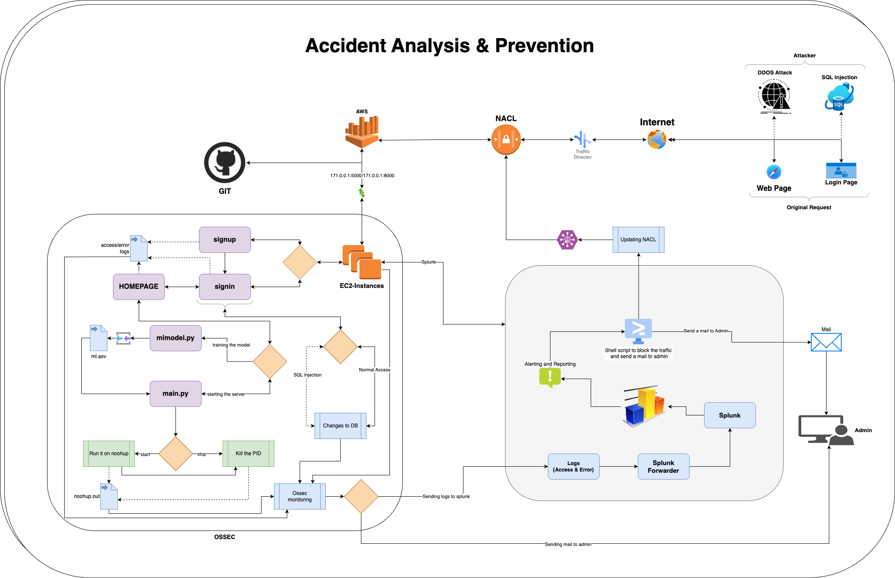
Software Architecture Diagram
NETWORK SECURITY- GROUP3

Slide 14
Threat Model
DDOS Attack
In our proposed solution, The IP address of the server which sends packets to halt the service is isolated.
SQL Injection Attack
Adding client-side validations for username.
NETWORK SECURITY- GROUP3

Slide 15
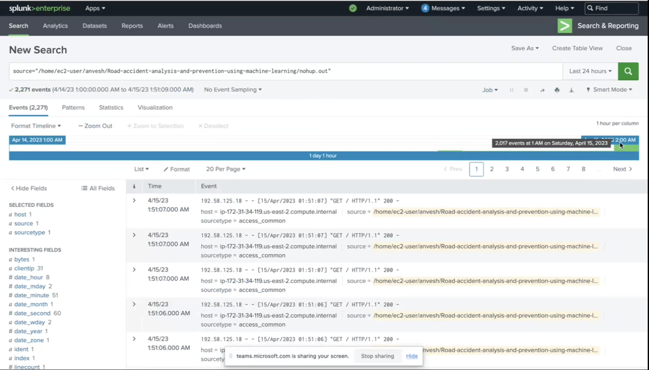
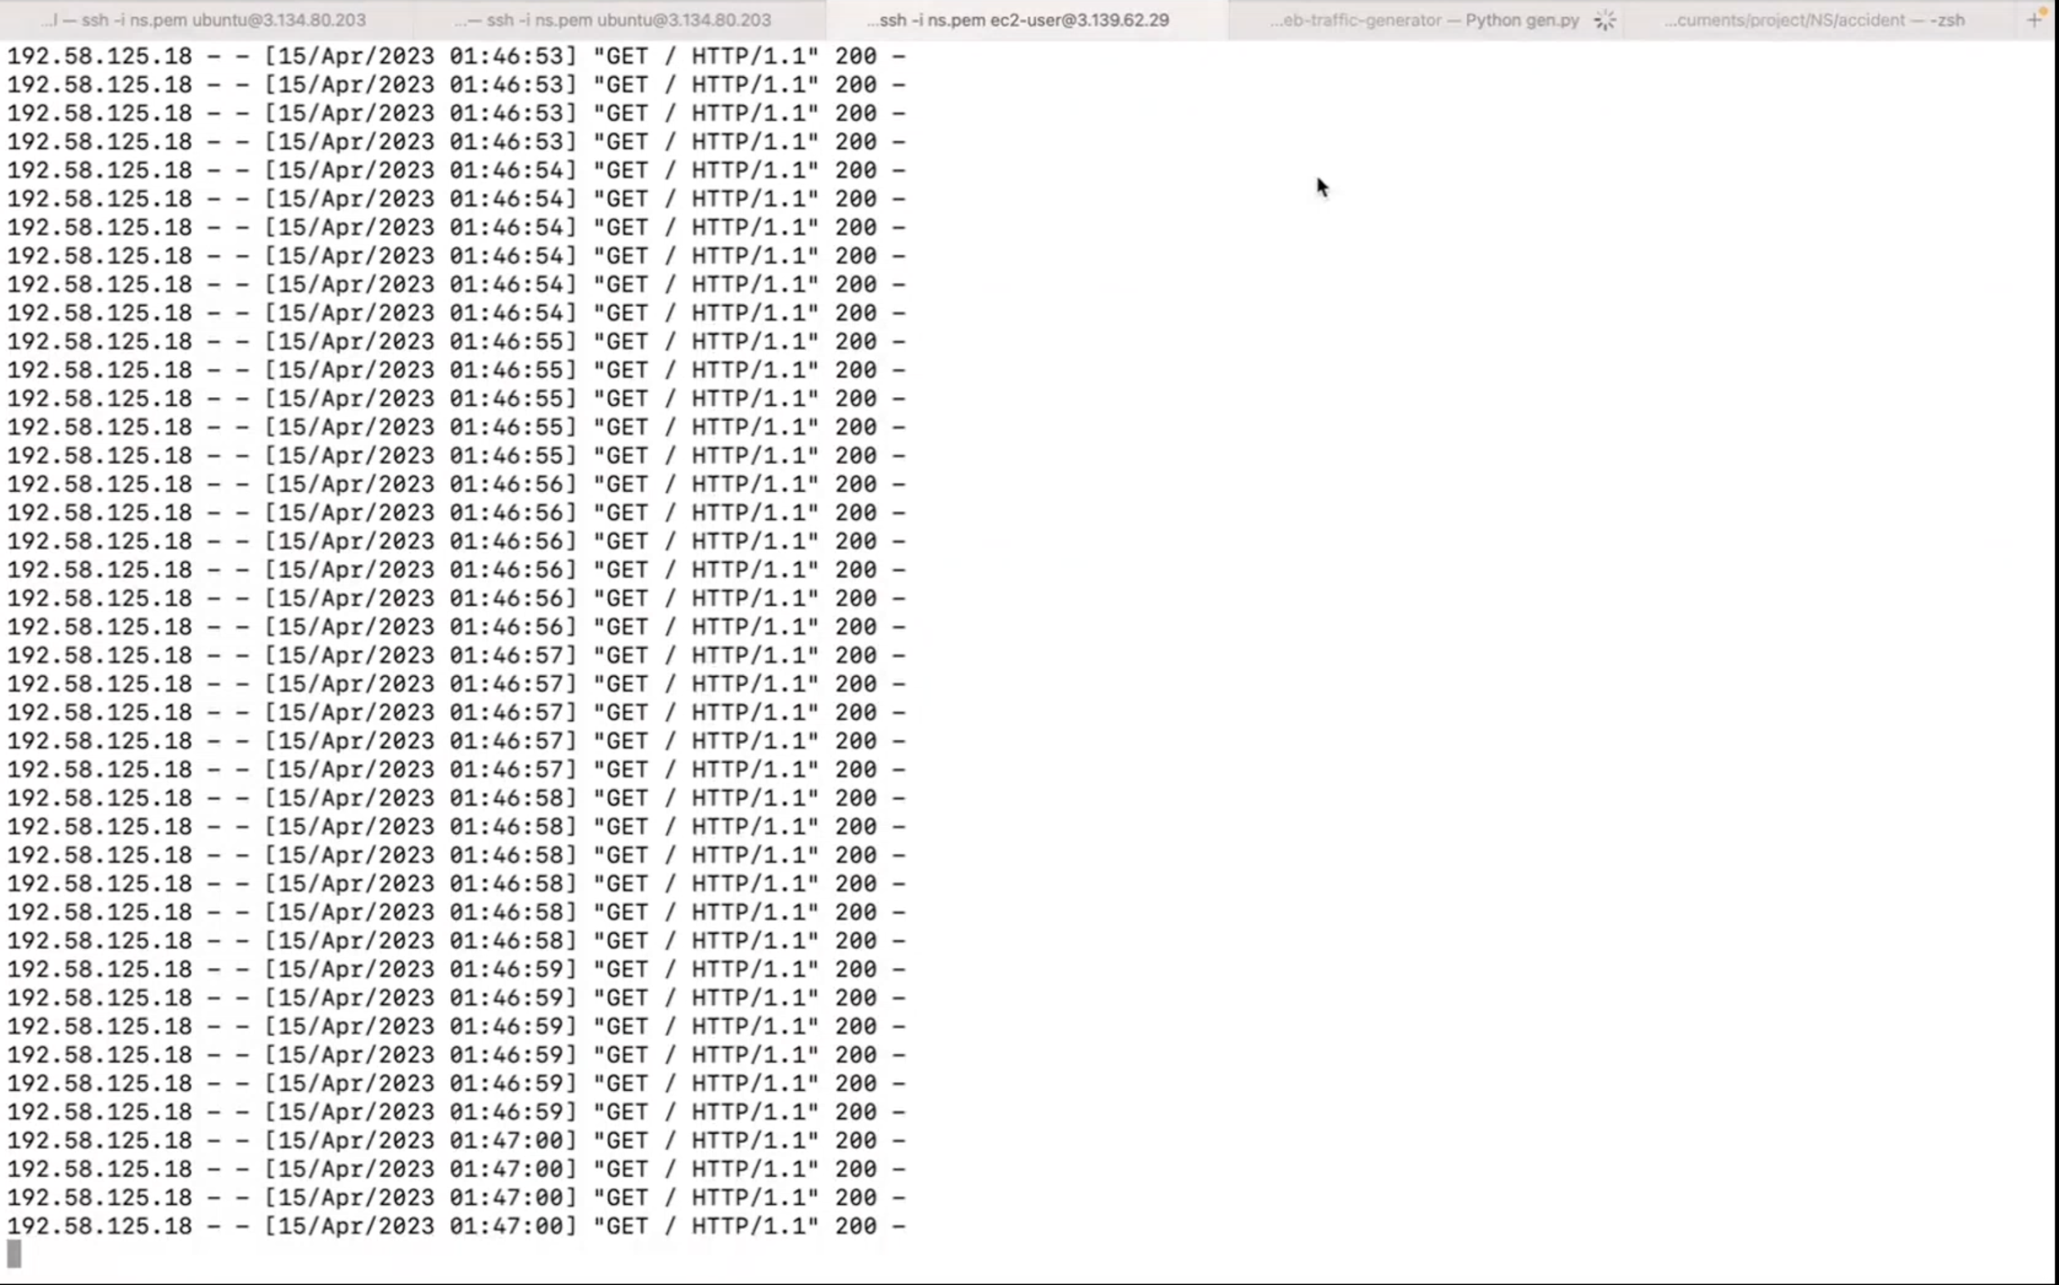
Experimental Results
NETWORK SECURITY- GROUP3

Slide 16
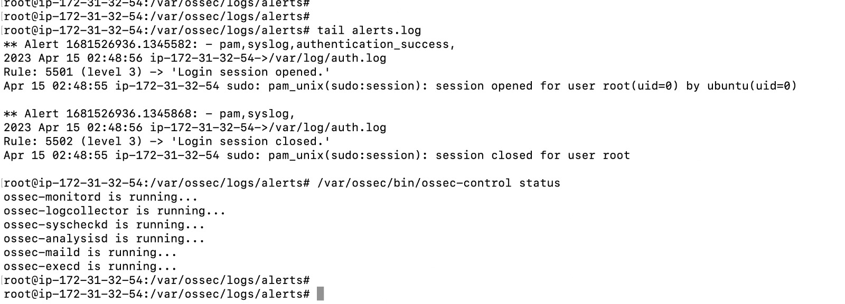
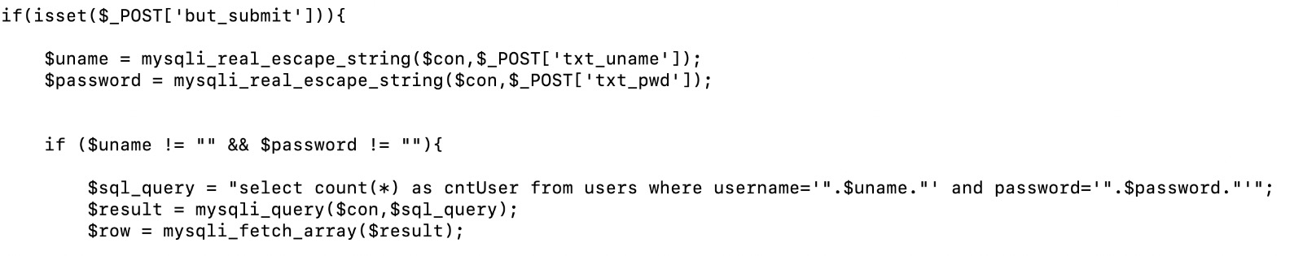
Experimental Results(cont.)

Slide 17

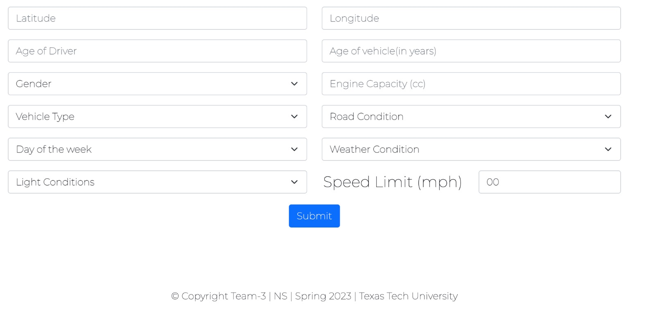
Experimental Results(cont.)

Slide 18
Pros and Cons
Pros-
One can get accident severity at a particular location.
The proposed solution is resistant from DDOS attack and SQL injection attack.
Alerting the admins with the required information about the attacks.
Cons-
There are possible of XSS, man in the middle attacks which can happen.
Shell script is unable to get the exact IP address of the attacker to block.
NETWORK SECURITY- GROUP3

Slide 19
Issues Experienced
Blocking IP address causing DDOS attack:
Faced an issue to block the IP address from the Splunk. We used AWSCLI concept to overcome this issue.
Facing the resources issues with the main.py execution.
Getting the all logs into the Splunk server and maintain.
NETWORK SECURITY- GROUP3

Slide 20
Conclusion
Developed a dynamic website(AWS based) which would be helpful for the drivers and pedestrian's by analyzing the accidents. Also, the same website is introduced with the possible attacks such as DDOS, and SQL Injections followed by the mitigation mechanisms to the attacks. Also alerting the admins with the required information to alert towards the attacks with the help of Splunk and shell scripts.
NETWORK SECURITY- GROUP3

Slide 21
Future Development
For the future development, We can mitigate more attacks and also improve the accuracy of the model using Random Forest Classifier.
Also, we can improve the alerting mechanisms with appropriate information to help the investigation of the attacks.
We can improve the alerting script to block the exact IP of the attacker.

Slide 22
References
Exposure to pedestrian crash based on household survey data: Effect of trip purpose - ScienceDirect
https://aws.amazon.com/ec2/
https://www.splunk.com/
https://www.ossec.net/
https://docs.aws.amazon.com/vpc/latest/userguide/vpc-network-acls.html

Slide 23

Thank You

